Slide 1


Slide 1
Data Harvest Team Presentation
Charlotte, Neela, Tumi
January 12 2019

Slide 2





Dr. Michael Blurry, PhD The ”Big Short” investor who got rich by shorting Real Estate before the 2008 financial crisis
By 2050, world demand for will be 40% greater than due to increased demand, rising population and climate change.
“agricultural land, productive land with water on site will be valuable in the future”
”Growing food in water rich areas and selling it in water-poor areas is the least contentious and most sustainable method for water distribution”

Slide 3
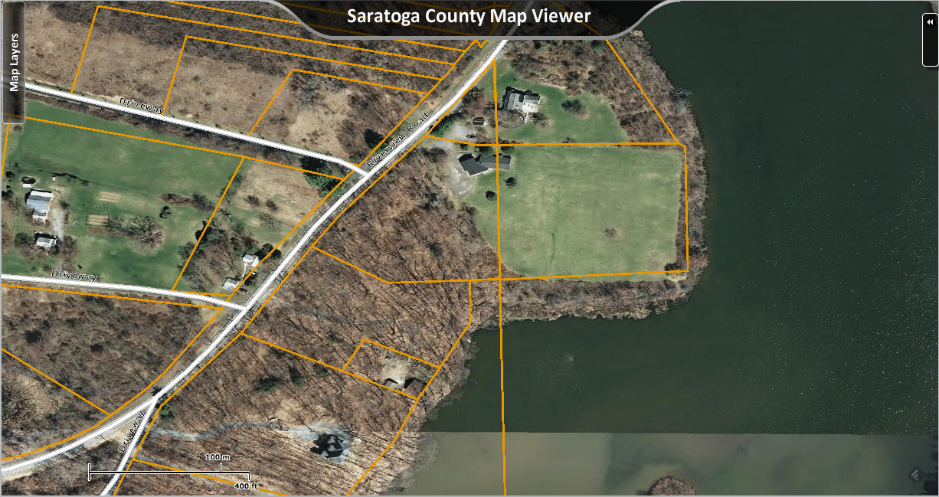
Guess where Tumi lives? Saratoga County upstate NY
How can I make money off of a small 6 acre farm in Saratoga County?

Slide 4
Economics favor large farms Consolidation 2000-2011
Farms 2000+ Acres
+10% 2000-2011
34%
8%
Farms 1-99 Acres
Flat 2000-2011
$4.2B Venture Capital for Aggrotech Startups 2018
Popularity of meal kits like Hello Fresh and Blue Apron drive more investment
470 Chapter 12 bankruptcies in 2018
Increasing suicides for small farmers
Farms 500-199 Acres
(-5%)2000-2011
36%
21%
Farms 100-499 Acres
(-6%)2000-2011

Slide 5
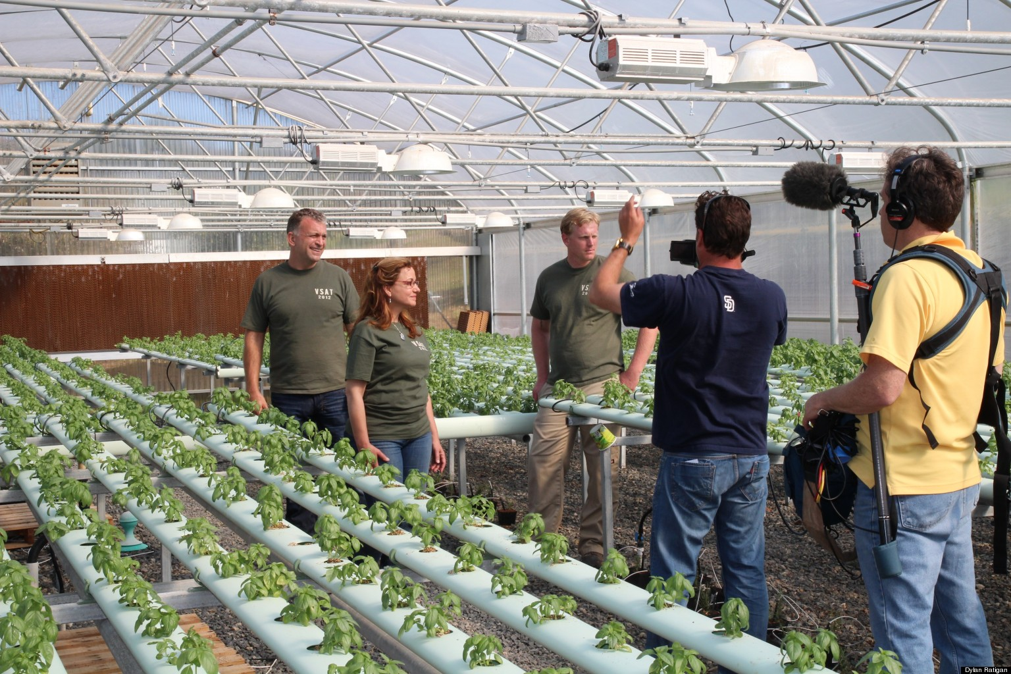
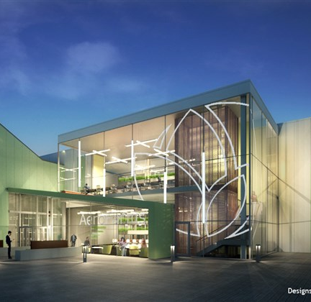
NEWARK NJ AEROFARMS THE LARGEST VERTICAL INDOOR FARMING FACILITY IN THE US (69,000 SQ FT) VC BACKED
Vertical farming involves converting buildings into high-tech grow houses that use artificial lighting, hydroponics, and climate control to increase crop productivity 70 times greater than field farmers.
DYLAN RATTIGAN NBC FINANCIAL REPORTER LEFT HIS JOB TO WORK FOR A HYDROPONIC FARM
Inspired by an Iraq veteran, and his wife, who spoke on his show about their efforts to build a high-yield hydroponic organic farm, as well as a school that trains veterans on how to open their own farms and organic businesses.

Slide 6
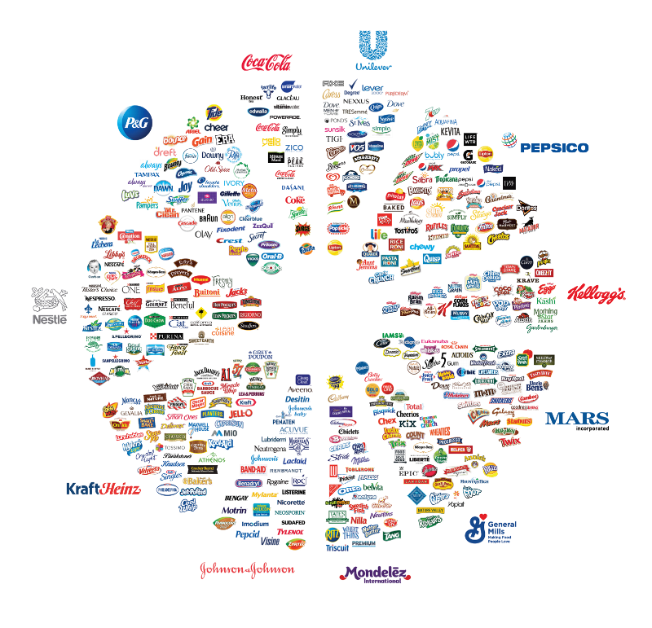
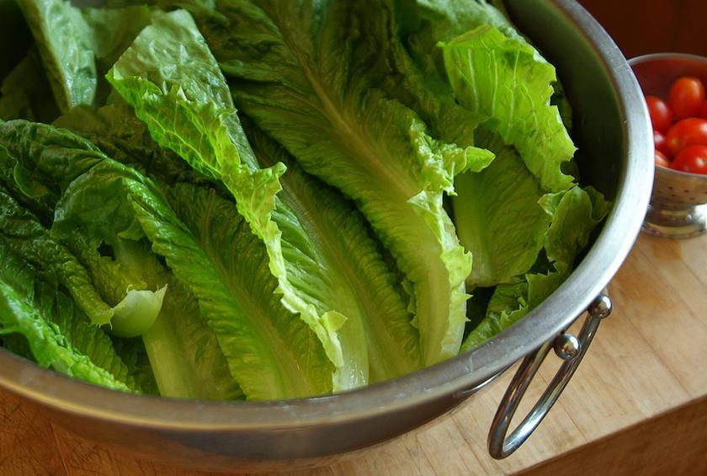
Farm consolidation comes at cost…
These 11 consumer companies control everything we buy
Consolidation of the food chain is a risk to national security
Yuma region ecoli outbreak resulted in a total of 210 illnesses, 96 hospitalizations,
Current FDA warning: avoid lettuce sourced from central coast of California

Slide 7
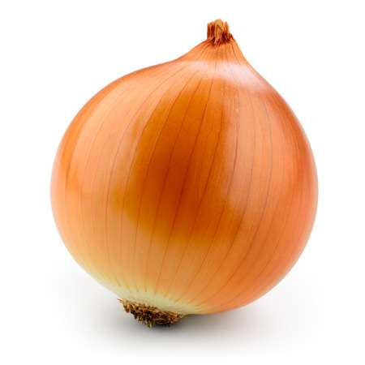
QUESTIONS What demand can small farmers meet in the food supply chain? What are the current challenges facing small farmers to having profitable, high yield farms? What products can small farmers focus on to increase profitability?
What CHALLENGES farm yield and profitability?
CHARLOTTE
Where is DEMAND highest for fresh produce?
TUMI
NEELA
Which PRODUCTS will be most profitable?
Tumi’s Protected farming in NY

Slide 8
DEMAND
What CHALLENGES farm yield and profitability?
CHARLOTTE
Where is DEMAND highest for fresh produce?
TUMI
NEELA
Which PRODUCTS will be most profitable?
TUMI
Tumi’s Protected farming in NY

Slide 9
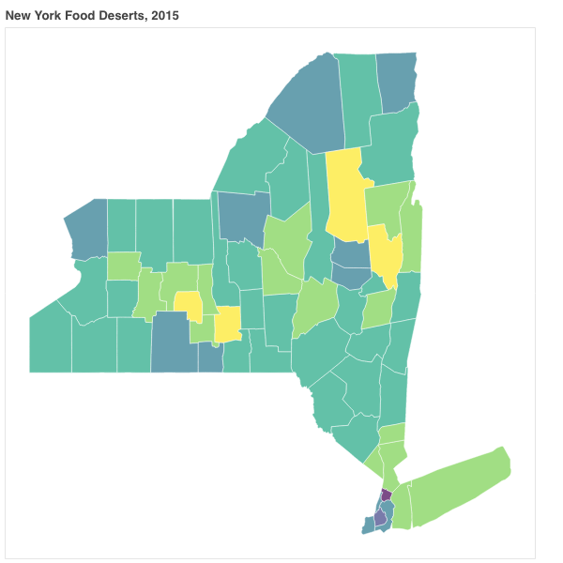
Food Deserts in NY State – Saratoga County
Food Deserts are geographic areas of the US (as defined by Census tracts) where low income, Grocery proximity or transportation access, keep nutritious food out of reach for a significant portion of the population.
Large grocers, do not service low income areas or some urban populations, and omnipresent Dollar stores do nothing to address food access, so achieving or maintaining healthy lifestyles, particularly for the vulnerable elderly and child populations is difficult.
SNAP (USDA Foodstamp programs) has expanded their vendor program to include farmers’ markets however most farms have had to scale to commercial size to counter agricultural challenges like climate change, and economics, so serving this smaller customer group is not feasible.
30,000 Low Income, Low Access people live in Food Desserts in Saratoga County
14% of Saratoga County struggles with Food Access.

Slide 10
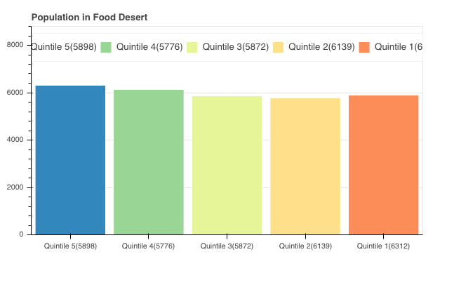
Saratoga Food Access Varies by Quintile
Each Quintile has similar populations, with different concentrations of people with low access to fresh produce.
Food Deserts are concentrated in small urban areas with high populations of low income, low mobility.
9%
19%
17%
16%
23%

Slide 11
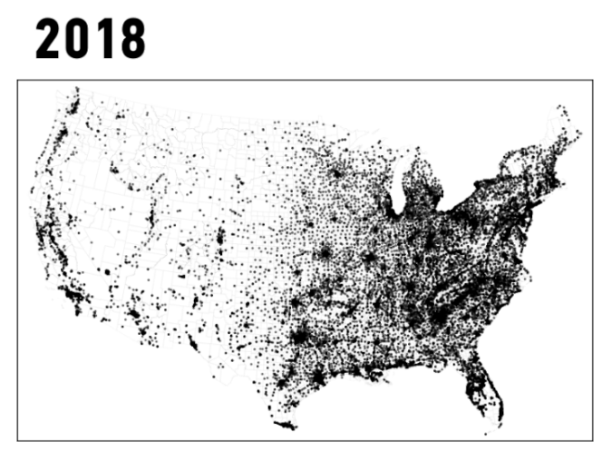
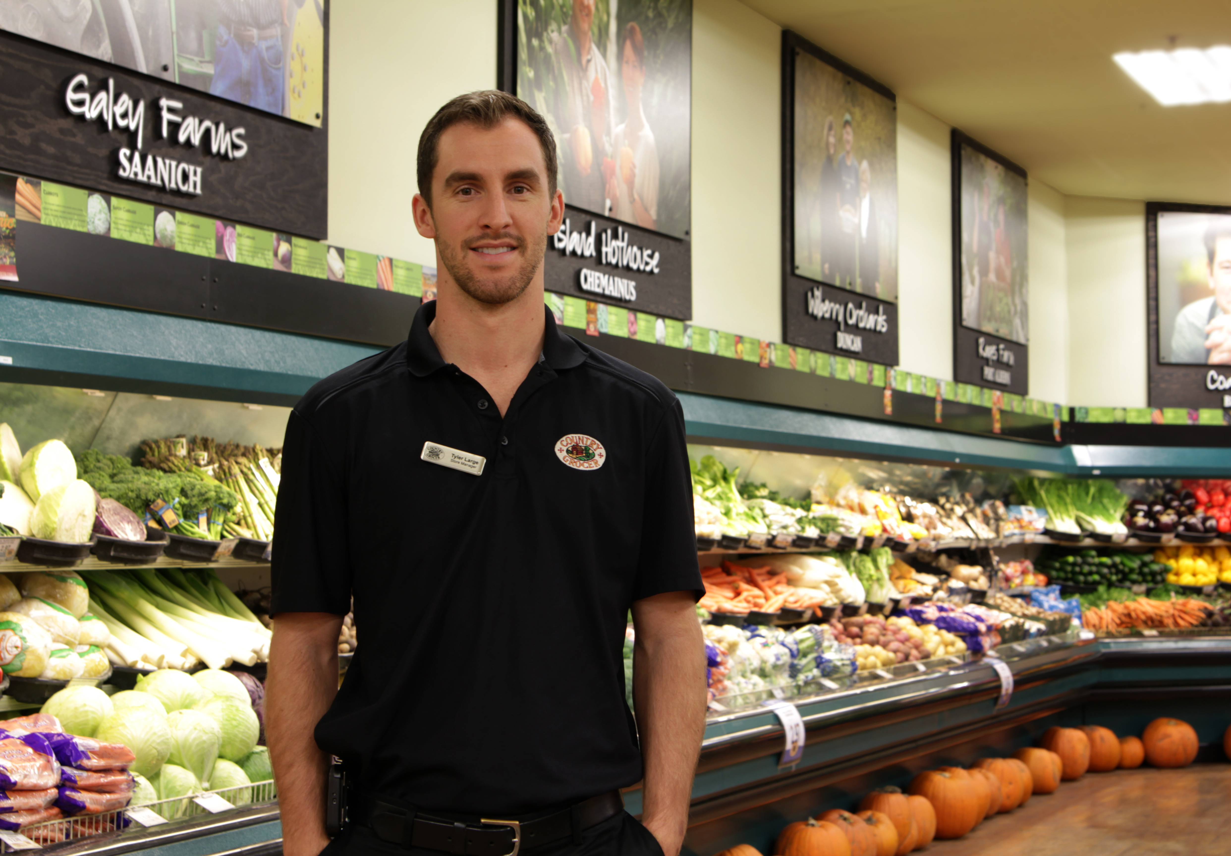
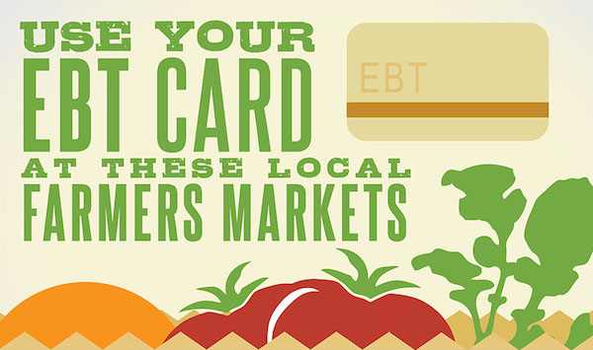
Grocers have left; Dollar stores no competition
LARGE GROCERS DON’T SERVE LOW INCOME, URBAN AREAS
DOLLAR STORES WITH NO FRESH PRODUCE PROLIFERATE
SNAP (FOOD STAMPS) PROGARM EXPANDED TO FARMERS MARKETS

Slide 12
CHALLENGES TO YIELD
What CHALLENGES farm yield and profitability?
CHARLOTTE
Where is DEMAND highest for fresh produce?
TUMI
NEELA
Which PRODUCTS will be most profitable?
CHARLOTTE
Tumi’s Protected farming in NY

Slide 13
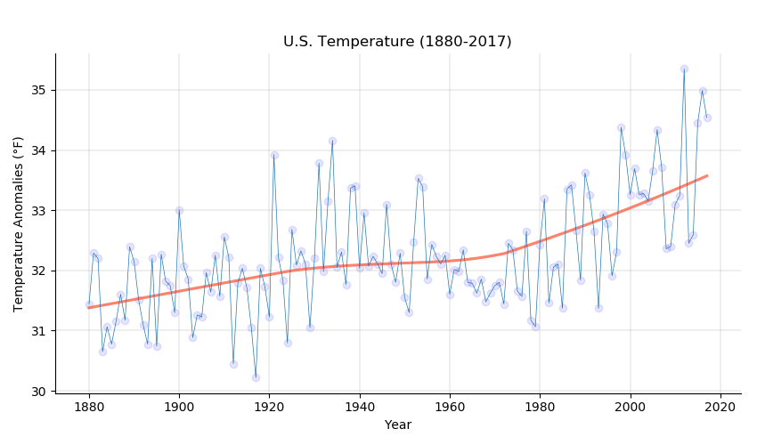
Frequency and magnitude of US anomalies
Increase of frequency and magnitude of outliers impacts farmers’
ability to predict growing conditions and plan accordingly.

Slide 14
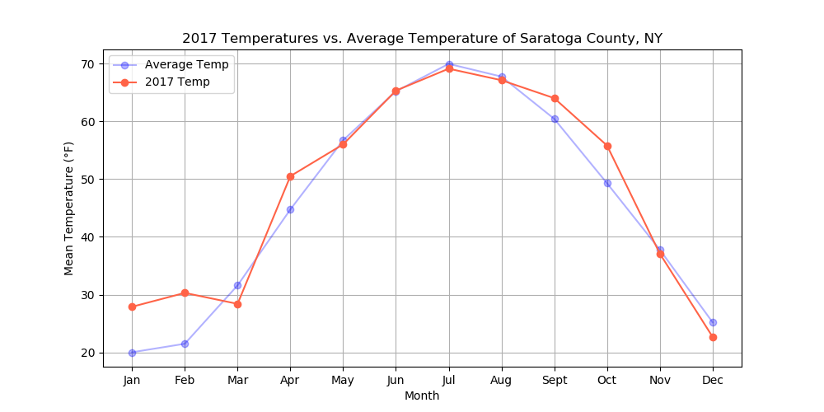
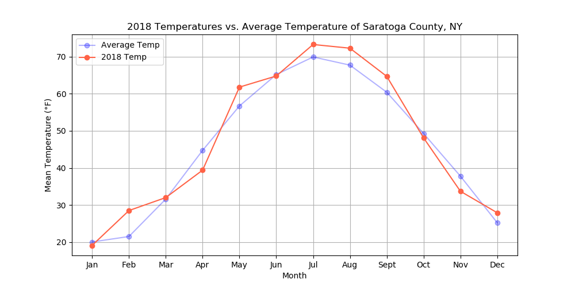
START AND END TO GROWING SEASON LESS PREDICATABLE
Saratoga’s 2017 winter and 2018 summer warmer than usual.

Slide 15
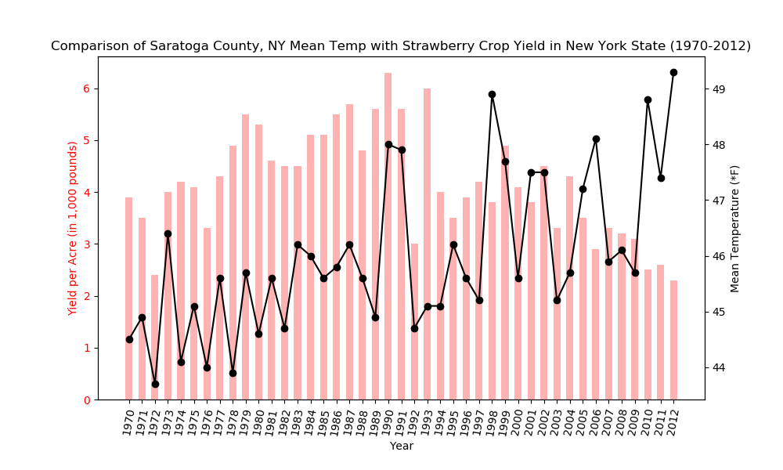
Strawberry yield vs. avg. temp saratoga
Possible impact of 25 year increasing temperature/variance on yield of particular crop in region

Slide 16
SUPPLY
What CHALLENGES farm yield and profitability?
CHARLOTTE
Where is DEMAND highest for fresh produce?
TUMI
NEELA
Which PRODUCTS will be most profitable?
NEELA
Tumi’s Protected farming in NY

Slide 17
Vegetable prices for 2017 across US
Data shows that Asparagus is the most expensive vegetable with a price of $ 118/cwt (cwt = 100 lb count) making the top of the chart in terms of price. However, potatoes are the least expensive with a cost of 10.57 $/cwt

Slide 18
Fresh Vegetable per capita availability 2017
Results indicate that although Potatoes are cheapest compared to other vegetables, the per capita availability of Potatoes are the highest with 33 lbs. Following potatoes are Onions (22 lb) and Tomatoes (21 lb). The lowest per capita availability was for Spinach(1.67 lb), Asparagus (1.58 lb) and Snap Beans (1.51 lb)

Slide 19
Fresh Vegetable Availability Trendline from 1990 – 2017
Potatoes
Tomatoes
The trendline data shows that the highest demand over the years has been potatoes compared to other vegetables. However, in the recent years the per capita availability of Potatoes has dropped by 25%, and the demand for onions and tomatoes are increasing indicating that people are making healthy choices in their diet

Slide 20
Fresh Vegetable Market Price Trendline from 2000 to 2017
Tomatoes
Potatoes
The comparative trendline data shows that comparatively the cost of tomatoes have been highest over the years with potatoes been the least. Over the decade, the price of tomatoes have not changed considerably

Slide 21
Vegetable Revenue Per Capita Trendline from 1990 – 2017
Tomatoes
The Revenue Per Capita trendline data across US shows that the highest revenue generated is from tomatoes compared to other vegetables

Slide 22
Comparison of Prices between Conventional and Organic for Vegetable across US
The prices for Organically grown vegetables are slightly higher than that of conventionally grown vegetables

Slide 23
Comparison of Prices between Conventional and Organic for Fruits across US
The prices for Organically grown fruits are slightly higher than that of conventionally grown fruits. The price for strawberries was missing from the data set

Slide 24
Revenue Generated Per Acre for Vegetables in NY State in 2017
The highest revenue generated per acre for the year 2017 in New York State area among all the vegetables is that from the Onions with $7,249 per acre land

Slide 25
Revenue Generated Per Acre for Fruits in NY State in 2017
Strawberries have generated the highest revenue per acre for the year 2017 in New York State area compared to other fruits with $ 8661 per acre

Slide 26
Challenges
Data access and lack of availability of desired data sets from the government websites were some of the challenges in this project
USDA websites were shut down resulting in difficulty in obtaining the API key
Due to lack of availability of Organic vs Conventional data regarding the price for vegetable and fruits in NY only the national data has been included
Data cleaning helped remove some unwanted data columns from the data set obtained from the USDA websites
Data cleaning examples such as : commas need to be removed from the price and quantity columns in the data set; data set for all vegetables and fruits were available in rows and needed to be converted into columns

Slide 27
Conclusions
Results from data analyses of various data sets for vegetables across US regions show that per capita trendline shows that the population is changing to healthy eating habits and consumption of potatoes per capita has gone down by 25% while tomatoes have gone up 25% and leafy vegetables have tripled during the same period. The prices for tomatoes and leafy vegetables have also gone up during the same period.
Results from data analyses of data sets for vegetables and fruits in the New York state for the year 2017 show that Onions and Strawberries have generated higher revenue ($ per acre). Results indicate that not all vegetables are grown in this area which provides opportunity to grow high demand vegetables like greens and tomatoes in protected farming.
Overall, the data shows that the prices for Organically grown vegetables and fruits are slightly higher than that of conventionally grown vegetables and fruits. Given that production costs for of organic produce is higher, we don’t know if it is feasible for profitability to the growers.
This information provides insight to Tumi as to select the type of vegetables and fruits for growing in a protected farm in the New York area.

Slide 28

Slide 10
THANK YOU

